Slide 1

INSURANCE FRAUD DETECTION USING MACHINE LEARNING
REVIEW 1 Under the guidance of Prof. T. Ramesh - Asst Prof CSE Presented by Mr. Syed Atif 20171CSE0702 Mr. Syed Shoaib 20171CSE0709 Mr. Tejas Bhatnagar 20171CSE0721 Mr. Thanuj Kumar S 20171CSE0726 Mr. Utsav Deep 20171CSE0734
PRESIDENCY UNIVERSITY

Slide 2
TABLE OF CONTENTS
Abstract
Introduction
Literature Survey
Objective
System flow design
Methodology
Transformation phase
Progress as of now
Work under process
References

Slide 3
INTRODUCTION
The insurance industries consist of more than thousand companies in worldwide. And collect more than one trillions of dollars premiums in each year. The vehicle insurance fraud is the most prominent type of insurance fraud, which can be done by fake accident claim. In this project, focusing on detecting the vehicle fraud by using, machine learning techniques.

Slide 4
INTRODUCTION
Introduction to Machine Learning
Machine Learning is said as a subset of Artificial intelligence that is mainly concerned with the development of algorithms which allow a computer to learn from the data and past experiences on their own.
Machine learning uses data to detect various patterns in a given dataset.
It can learn from past data and improve automatically.
Machine learning is much similar to data mining as it also deals with the huge amount of the data.

Slide 5
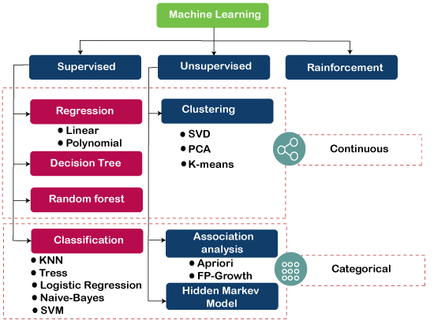
Types of Machine Learning Algorithms

Slide 6
INTRODUCTION
Introduction to Insurance Fraud Detection
Fraud is one of the largest and most well-known problems that insurers face. Fraudulent claims can be highly expensive for each insurer. Therefore, it is important to know which claims are correct and which are not.
Ideally, an insurance agent would have the capacity to investigate each case and conclude whether it is genuine or not. However, this process is not only time consuming, but costly. Sourcing and funding the skilled labor required to review each of the thousands of claims that are filed a day is simply unfeasible.
This is where machine learning comes in to save the day. Once the proper data is fed to the system it'll be very easy to find out if the claim is genuine or not.

Slide 7
LITERATURE SURVEY
Authors | Year | Name of the Paper | Problem Address/Objectives
T. Badriyah, Lailul Rahmaniah I. Syarif K. Supraja and S.J. Saritha | 2018 2017 | Nearest Neighbour and Statistics Method based for Detecting Fraud in Auto Insurance Robust Fuzzy rule based techniques to detect frauds in insurance | .Nearest Neighbour based Method Statistics Methods This study includes nearest neighbour method and interquartile method to detect fraud in car insurance data. From the results of the conducted study, the best result is using Nearest Neighbour The Fuzzy Rule based technique is applied on the training dataset and based on the instances the degree of fraud or Legal is predicted. Concluded that this technique is used for high dimensional large dataset with accuracy

Slide 8
LITERATURE SURVEY
Authors | Year | Name of the Paper | Problem Address/Objectives
Richard A. Bauder and Taghi M. Khoshgoftaar | 2017 2015 | Medicare Fraud Detection Using Machine Learning Methods Application of Data Mining Techniques in Health Fraud Detection | Supervised learner Unsupervised learner Hybrid learner In this Paper we explore different ML methods to detect fraudulent Medicare providers and concludes that supervised learners are better than others Classification algorithm ID3(Iterative Dichotomise 3) J48 Naive bayes Based on survey they concluded that the decision tree ID3 is the best in the three respective algorithm as it is more accurate
Rekha Pal
and
Saurabh Pal

Slide 9

OBJECTIVES
To build a classification methodology using machine learning technique to determine whether a customer is placing a fraudulent insurance claim by using historical data
Designing front end for our application
Deploying our application in cloud platform

Slide 10
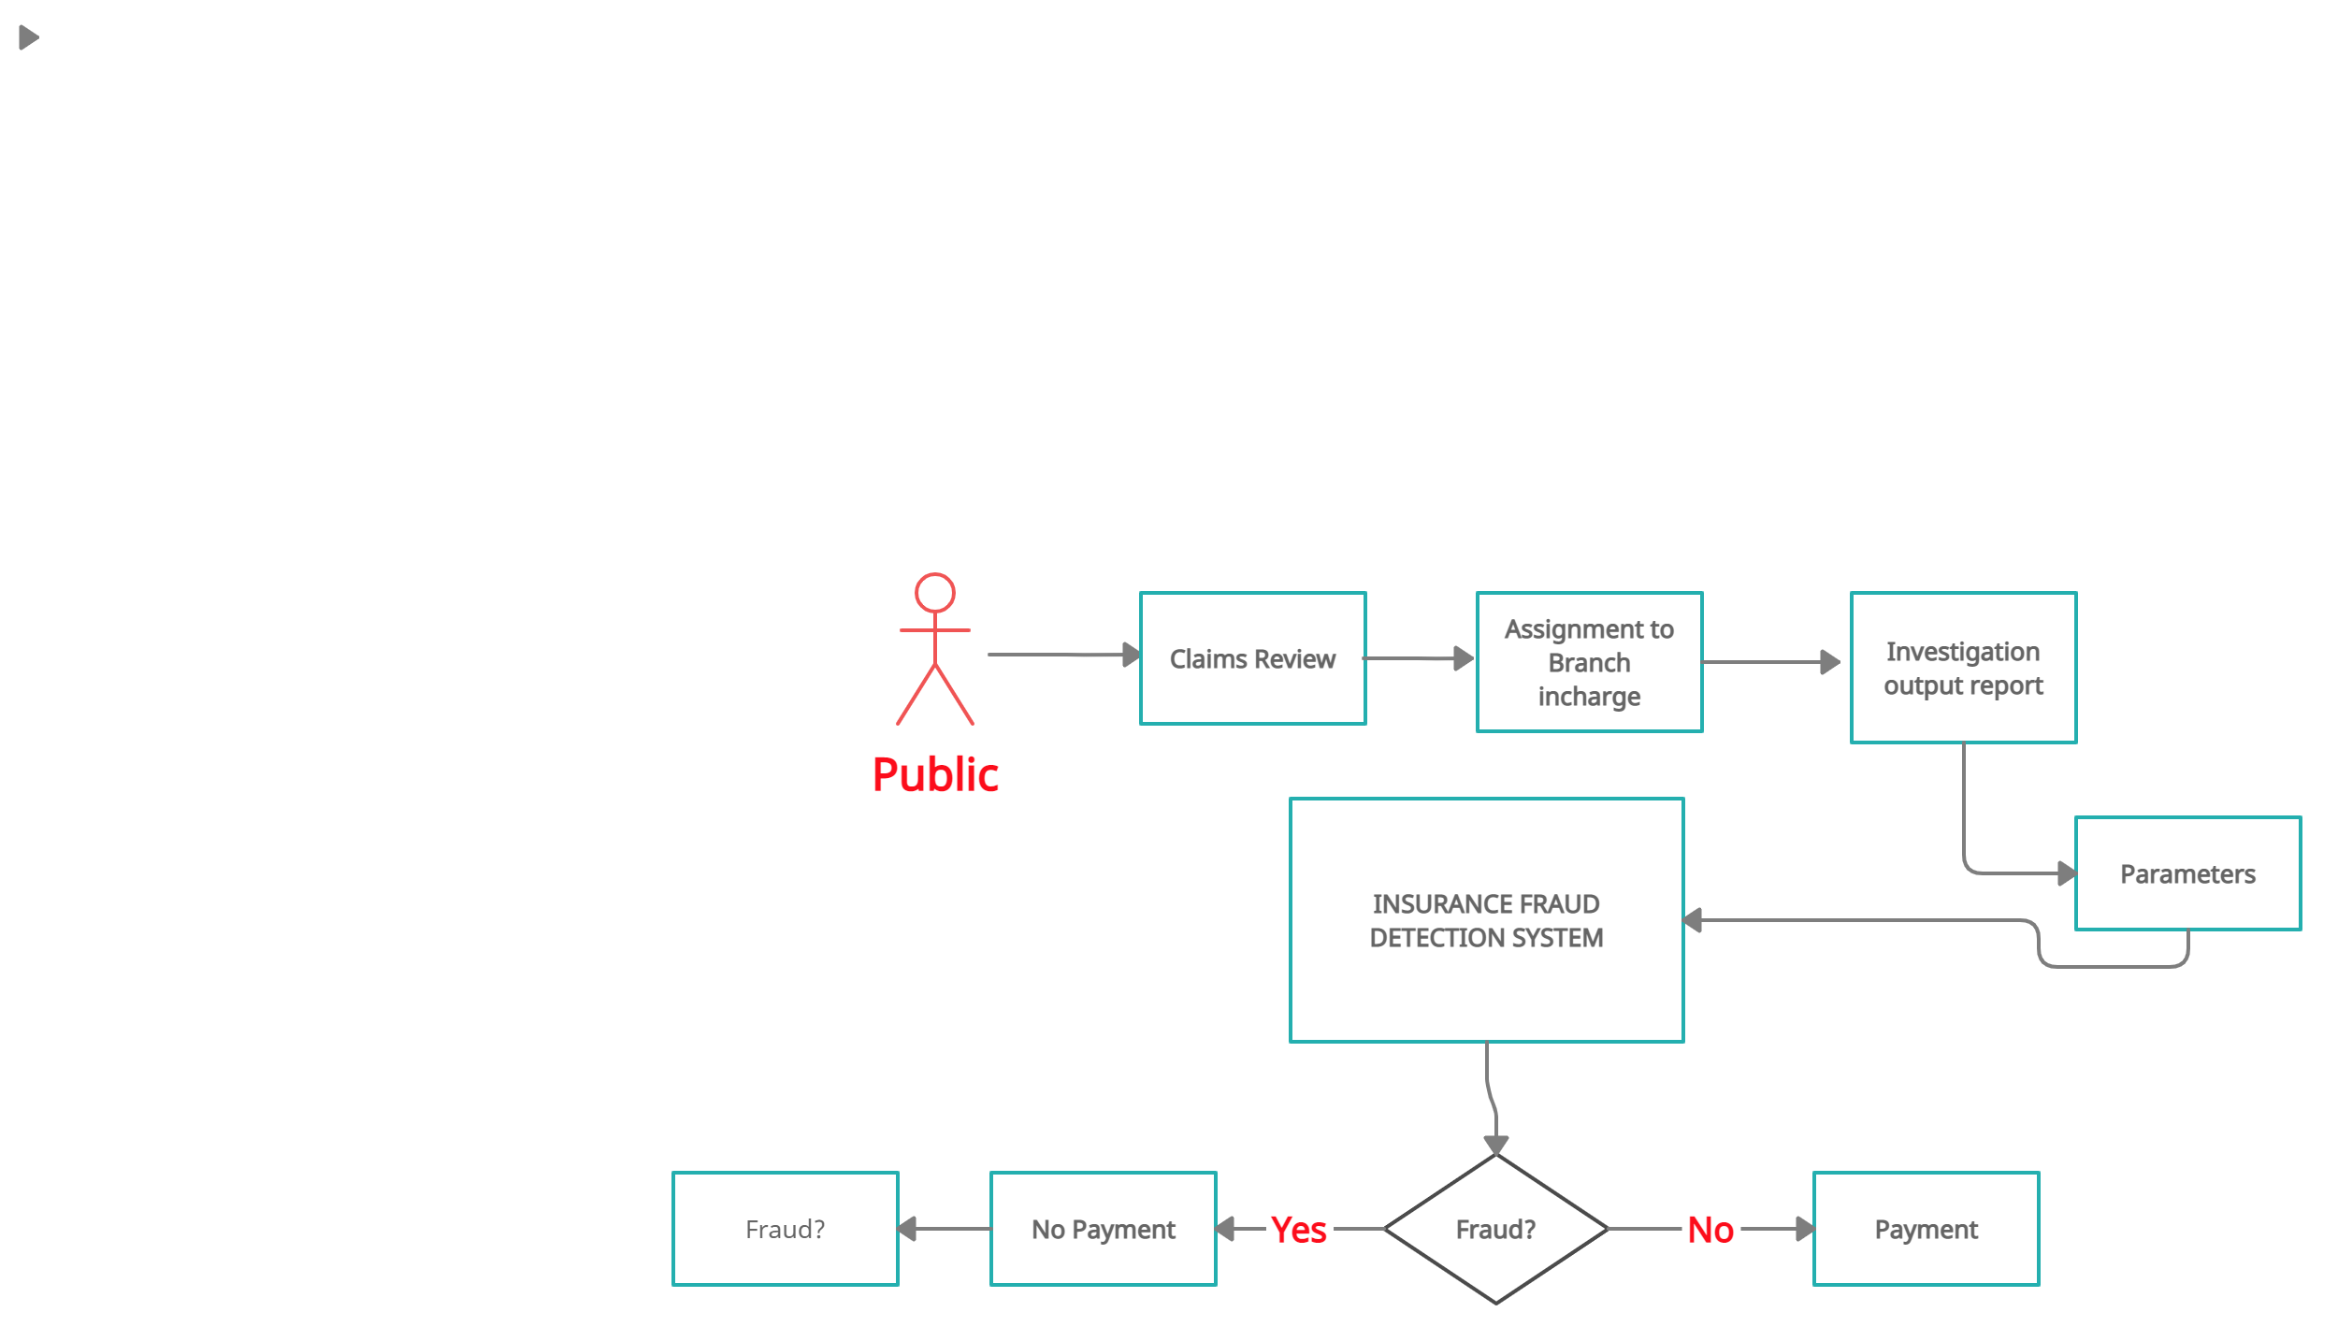
SYSTEM FLOW

Slide 11
METHODOLOGY
Machine learning algorithms required for this project
1. XG Boost
2. Support Vector Machine (SVM)

Slide 12
1. XG Boost
XGBoost is a machine learning library like numpy, tensorflow, pytorch
XGBoost is a useful tool to achieve good performance in the Kaggle or data science competitions
XGBoost is a popular and efficient open-source implementation of the gradient boosted trees algorithm.

Slide 13

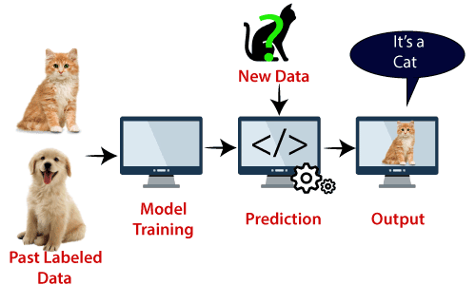
2. Support Vector Machine
Support Vector Machine or SVM is one of the most popular Supervised Learning algorithms, which is used for Classification as well as Regression problems. However, primarily, it is used for Classification problems in Machine Learning.

Slide 14
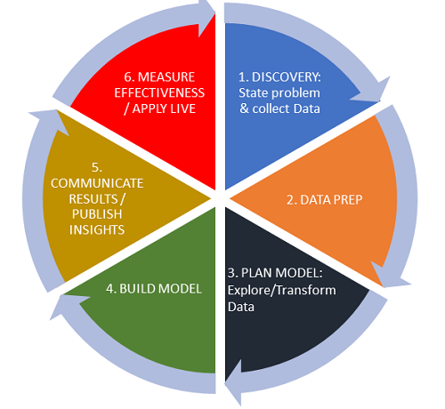
TRANSFORMATION PHASES
1. Data Collection & Validation
2. Data Pre-processing
3. Model Training

Slide 15
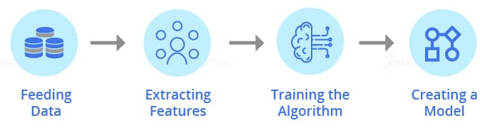
TRANSFORMATION PHASES
4. Model Selection
5. Prediction
6. Deployment in cloud platform as webapp

Slide 16
PROGRESS AS OF NOW
Done with Literature survey
Done with specification and requirements study
Designed system flow diagram
Collected the required dataset
Accomplished Data pre - processing stage

Slide 17
WORK UNDER PROCESS
Need to apply machine learning algorithms
Selecting best model based on accuracy
Designing front end for our application
Deploy using Cloud Services (Heroku Platform)

Slide 18
REFERENCES
1. T. Badriyah, Lailul Rahmaniah I. Syarif, Nearest Neighbour and Statistics Method based for Detecting Fraud in Auto Insurance,2018 International Conference on Applied Engineering (ICAE) [Link]
2. K. Supraja and S.J. Saritha, Robust fuzzy rule based technique to detect frauds in vehicle insurance,1-2 Aug. 2017 [Link]
3. Richard A. Bauder and Taghi M. Khoshgoftaar, Medicare Fraud Detection Using Machine Learning Methods,18-21 Dec. 2017 [Link]
4. Rekha Pal and Saurabh Pal, Application of Data Mining Techniques in Health Fraud Detection,, 2015 [Link]

Slide 19
THANK YOU

